Slide 1

Preventing Teen Pregnancy and Sexually Transmitted Infections

Slide 2
Washington PREP Overview
Teaches both abstinence and contraception
Focus is on prevention of pregnancy and sexually transmitted infections, including HIV/AIDS
Includes content on Healthy Relationships, Parent-Child Communication and Healthy Life Skills
Serves ages 11-21
Administered by Family and Youth Services Bureau (US Dept. of Health & Human Services)
Coordinated by WA Department of Health
Partnerships with OSPI and DSHS
CARDEA Services (training & technical assistance)

Slide 3
WHY PREP?
Early Sexual Involvement is related to:
  Lower grades
  Higher rates of depression
  Higher rates of alcohol use
  Higher rates of teen pregnancy
Evidence-based programs can significantly:
  Delay first intercourse
  Decrease sexual risk taking
  Increase condom and contraceptive use

Slide 4
Ever Had Sexual Intercourse
(HYS, 2012, Cowlitz Co.)
Notes:
Healthy Youth Survey, 2012, Cowlitz Co.

Slide 5
Getting lower grades (C’s, D’s, F’s) and sexual intercourse (HYS, Cowlitz Co., 2012)
Notes:
Healthy Youth Survey, 2012, Cowlitz Co.

Slide 6
Who Supports Comprehensive
Sexual Health Education?
Over 90% of Parents Nationwide
The U.S. Surgeon General
Centers for Disease Control
The American Academy of Pediatrics
The American School Health Assoc.
The National Education Association
Notes:
How many of you have talked to your parents about the Sex Ed that you’ve received?

Slide 7
Evidence Based Interventions (EBIs)
Already proven to work through rigorous evaluation

Slide 8
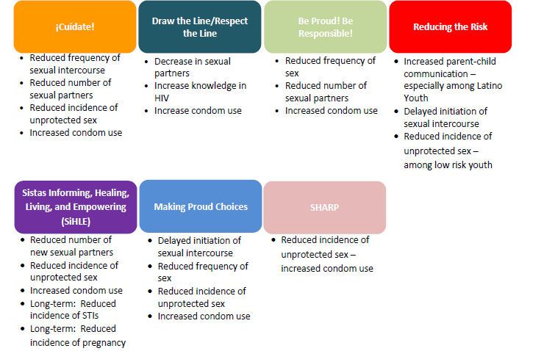
WA PREP
Evidence Based Interventions

Slide 9
Benefits of Reducing the Risk (RTR)
(results from WA PREP evaluation)
Would you say that being in the program (RTR) has made you more likely, about the same, or less likely to:
Resist or say no to peer pressure – 11.8% somewhat more likely; 29.4% much more likely
Abstain from sexual intercourse in the next 6 months – 5.9% somewhat more likely; 47.1% much more likely
Get a steady job after finishing school – 35.3% somewhat more likely; 47.1% much more likely
Make plans to reach goals – 29.4% somewhat more likely; 52.9% much more likely
Notes:
Results from other communities in WA State using RTR as part of WA PREP

Slide 10
Benefits of WA PREP
$10,000 implementation grant
In addition:
  Free curriculum and materials
  Free staff training
  Substitute and travel reimbursement for staff training days
  Technical assistance and support during and after the implementation year
  Continued staff training after the implementation year

Slide 11
Evaluation Requirements
Entry and Exit surveys for students
Facilitators complete fidelity monitoring logs after each session
Facilitators complete survey about PREP
CARDEA provides technical assistance

Slide 12
Intervention Partner Responsibilities
Committed facilitators
Attend trainings
Deliver curriculum with fidelity
Complete and submit evaluation materials
Focus on sustainability

Slide 13
WA PREP Contact Information
CARDEA
Brett Niessen
bniessen@cardeaservices.org
(206) 447-9538
OSPI
Laurie Dils
Laurie.dils@k12.wa.us
(360) 725-6368

